Slide 1
Project about tic and it’s technologies
Groupe 15:
-Lisri Akram -Chikh Mohamed Amine -Meghlaoui Ismail AbderRahim -Sellali Mohamed -Tifahi Mohamed

Slide 2
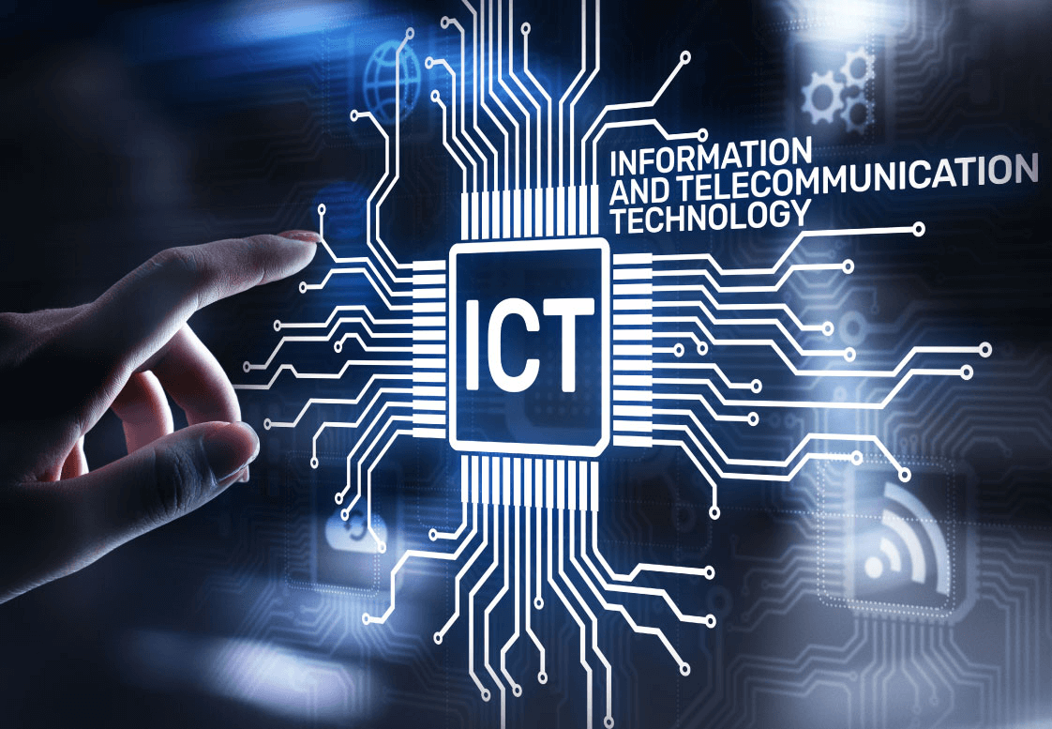
TIC are pivotal for driving global connectivity, fostering innovation, and enabling efficient communication in the digital era.

Slide 3
1- Introduction about TIC
In the current digital landscape, Information and Communication Technologies (ICT) have emerged as the backbone of our interconnected world, fundamentally reshaping the way we interact, communicate, and conduct business. ICT represents a diverse and dynamic suite of technologies and tools designed to acquire, process, store, transmit, and retrieve information. From the advent of the internet to the proliferation of smartphones, the transformative impact of ICT extends across every facet of our lives.
ICT is not merely a collection of technologies; it is an enabler of innovation, efficiency, and global connectivity. It encompasses a spectrum of components, including internet and networking infrastructure, cloud computing, artificial intelligence, cybersecurity solutions, and mobile technologies. As a catalyst for progress, ICT plays a pivotal role in shaping industries, driving economic growth, and fostering collaboration on a global scale.

Slide 4
Overview of TIC
In the ever-evolving landscape of the digital age, Information and Communication Technologies (TIC) stand as the bedrock of our interconnected world. TIC encompasses a diverse range of technologies and tools designed to gather, process, store, transmit, and retrieve information. From the advent of the internet to the proliferation of smartphones and the rise of artificial intelligence, TIC has revolutionized the way we live, work, and communicate.

Slide 5


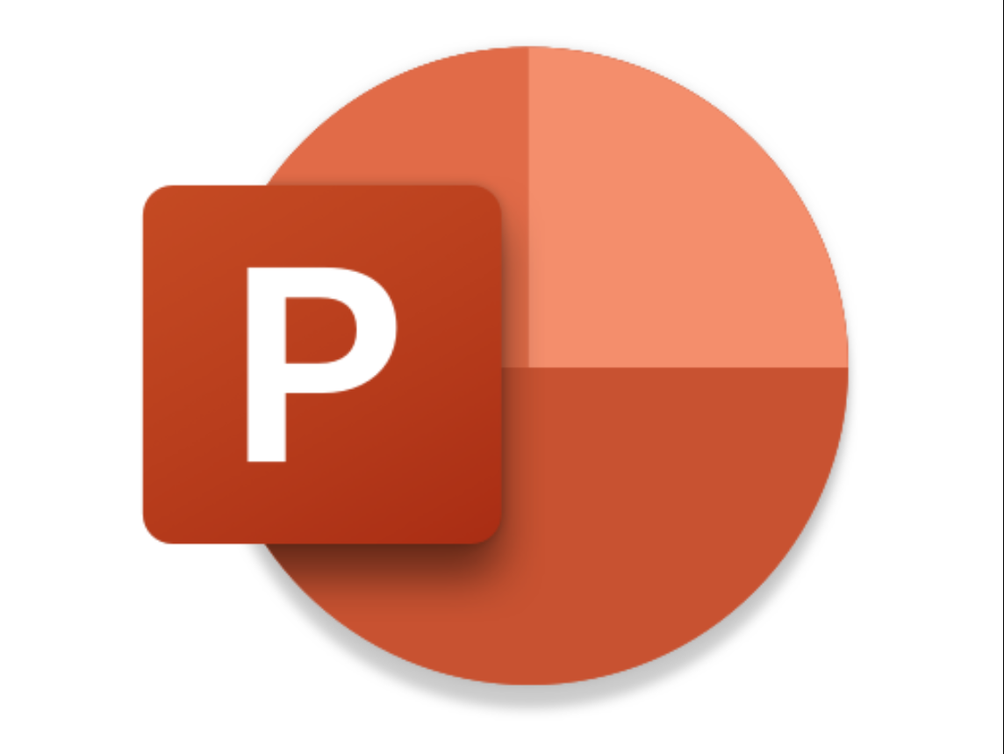


2- technologies related to TIC (tic tools)
When discussing Information and Communication Technologies (ICT), our thoughts often turn to a range of tools. Before delving into each application in detail, let's provide a brief overview of each.
Microsoft Word
Microsoft Excel
Microsoft Power Point
LaTex
Git and Github

Slide 6
2-1 microsoft office
Microsoft Office is a vital player in Information and Communication Technologies (ICT), offering essential tools like Word, Excel, and PowerPoint that are integral to IT engineering tasks, facilitating communication, data management, and presentation.
Word :
Microsoft Word, a fundamental component of Microsoft Office, serves as a versatile word processing tool for creating and editing documents.
Excel :
Microsoft Excel, an integral part of Microsoft Office, is a powerful spreadsheet application facilitating data management, analysis, and visualization for various tasks in IT engineering.
Power Point
Microsoft PowerPoint, a key element of Microsoft Office, provides a dynamic platform for creating engaging presentations, making it an essential tool in the realm of IT engineering.

Slide 7

2-2 Latex
LaTeX, a typesetting system known for its precision and adaptability, is a robust tool within the domain of Information and Communication Technologies (ICT).
Widely appreciated in IT, LaTeX excels in crafting professional and visually appealing documents, especially those involving scientific and mathematical content.
LaTeX is the preferred tool for crafting precise technical documents, while excelling in formatting and presenting IT engineering research papers, demonstrating its significant contribution in real-world scenarios.

Slide 8

2-3 Git and Github
Git and GitHub revolutionize collaborative software development in Information and Communication Technologies (ICT). Git, a distributed version control system, allows developers to track changes and maintain project history, while GitHub, a web-based platform, serves as a centralized hub for hosting, issue tracking, and pull requests, streamlining collaboration. Git's branching feature supports parallel development, enabling teams to work concurrently on diverse aspects of a project.

Slide 9
conclusion
This exploration provides a comprehensive overview of Information and Communication Technologies (ICT) and key tools such as Microsoft Office, LaTeX, and Git with GitHub. Each section highlights the importance, features, and practical applications of these technologies within the realm of IT engineering.
Information and Communication Technologies (ICT) stand as the linchpin of our modern existence, orchestrating a symphony of connectivity, innovation, and efficiency. As we navigate the ever-evolving digital landscape, ICT's pervasive influence is unmistakable, permeating every aspect of our personal and professional lives.

Slide 10
Thank You

